Slide 1
FLOOR MOUNTED CLOTH DRYING SYSTEM USING FANS
:Project Guide:
Mr. Mrugendra Vasmatkar
Presented By:
Ganesh Gaonkar(15)
Omkar Jambhale(20)
Deepak Mishra(29)
Labhesh Patil(37)
Neerav Thakur(54)

Slide 2
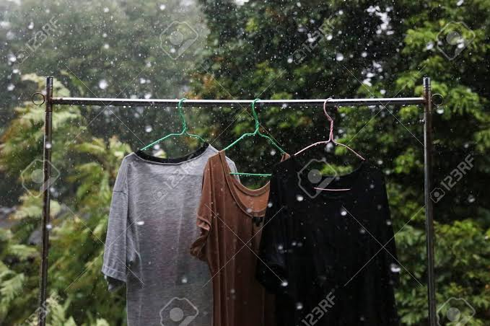
INTRODUCTION
In rainy season or during cloudy weather it becomes very difficult to dry the wet clothes.
And also it require lot of time to dry.

Slide 3
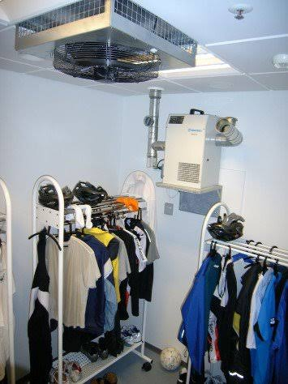
AGENDA
To develop a system to dry the wet clothes indoors effectively.
And also Develop time consuming product for drying of wet clothes.

Slide 4
HARDWARE REQUIRMENTS
Cloth drying stand
Arduino UNO
Motor driver(L298)
DC Motors (18000 rpm)
2 Fans
12 Volt DC supply

Slide 5
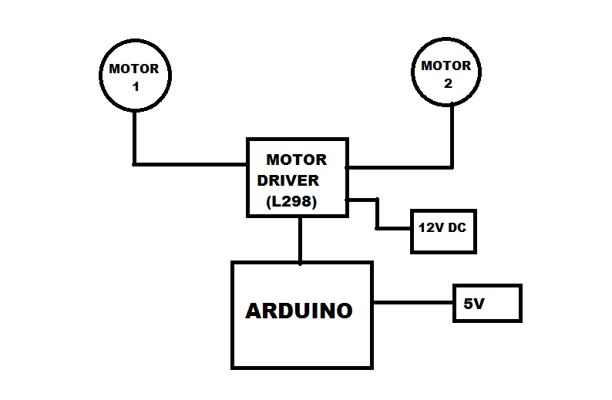
BLOCK DIAGRAM

Slide 6
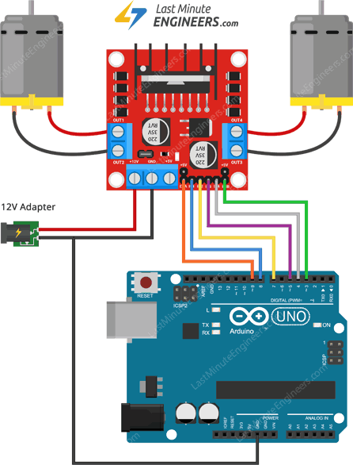
ARDUINO UNO INTERFACING WITH L298

Slide 7
ADVANTAGES
Effective drying of clothes
Time consuming
Compatible and easy to use
DISADVANTAGES
Expensive

Slide 8
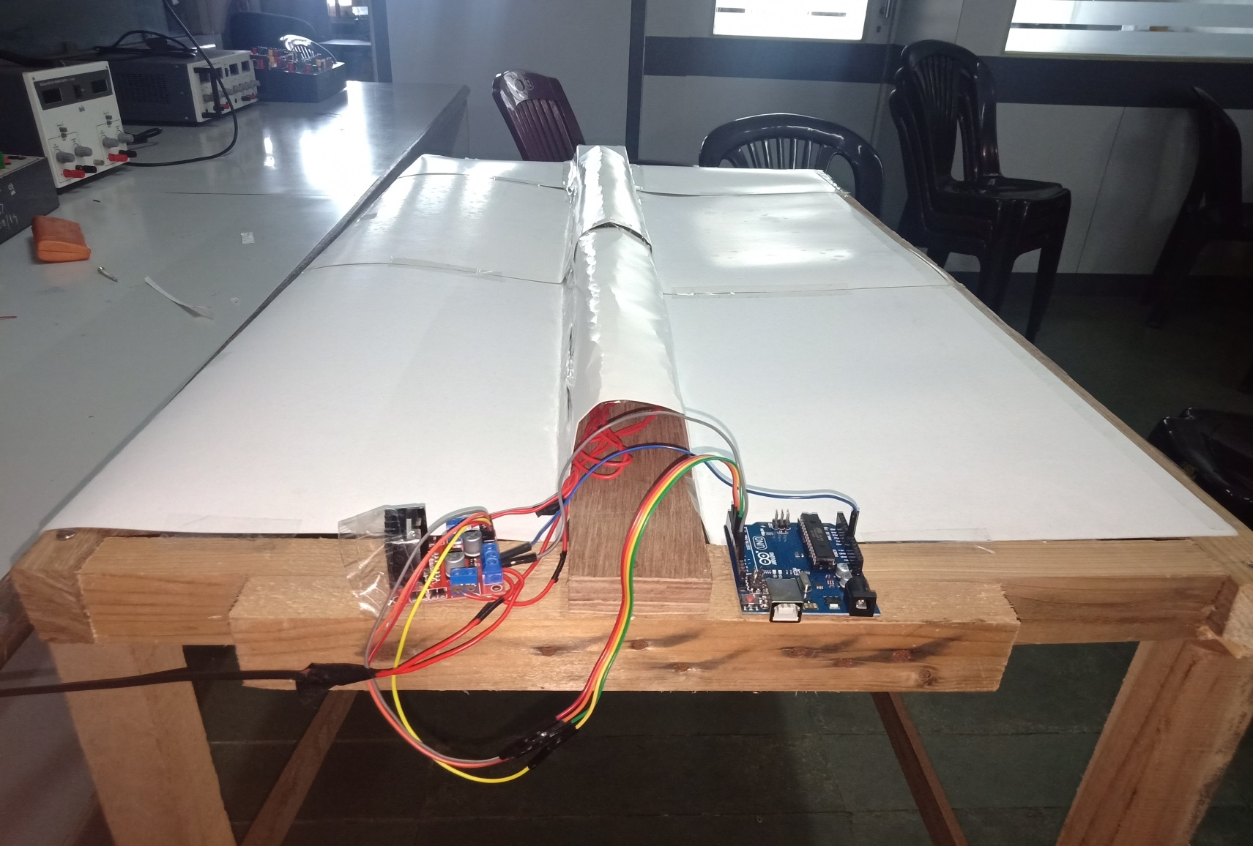
PROJECT

Slide 9
FUTURE SCOPE
For more convenience wheels can be attached to the stand.
Use of heater along with the fans can help for more effective performance.

Slide 10


